Slide 1
Islam and Mathematics:
A Story of Cooperation and Peace
Pat McKeague
August 2016
Presentation Slides: www.mckeague.com

Slide 2
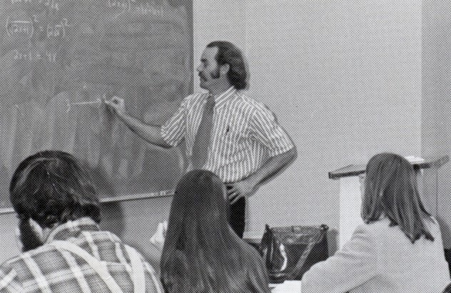
Cuesta College 1974

Slide 3
Elementary Algebra Themes
Method I reserve five minutes of each class session to bring in the things that you think are interesting in, and around, mathematics.
Target Audiences
All Students
Student like me in the 60s
Muslim Student

Slide 4
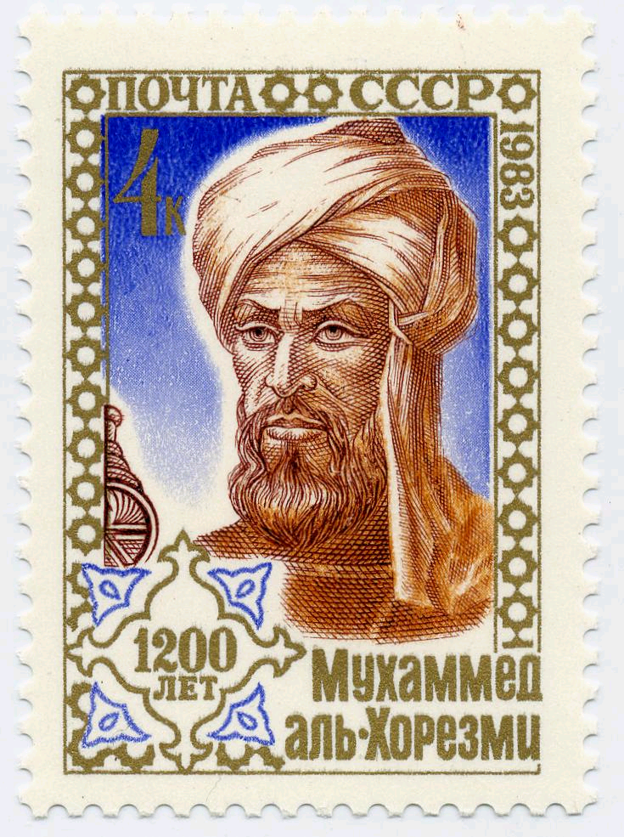
Why do We Call it Algebra?
Postage stamp issued by the Soviet Union in 1983, to mark the 1200th anniversary of the birth of Al-Khwarizmi in 783.
Khwarizmi
is now
Khiva
in Uzbekistan
Abu Ja'far Mohammed ibn Musa Al-Khwarizmi
Father of Ja'far, Mohammed, son of Moses, native of the town of Al-Khwarizmi

Slide 5
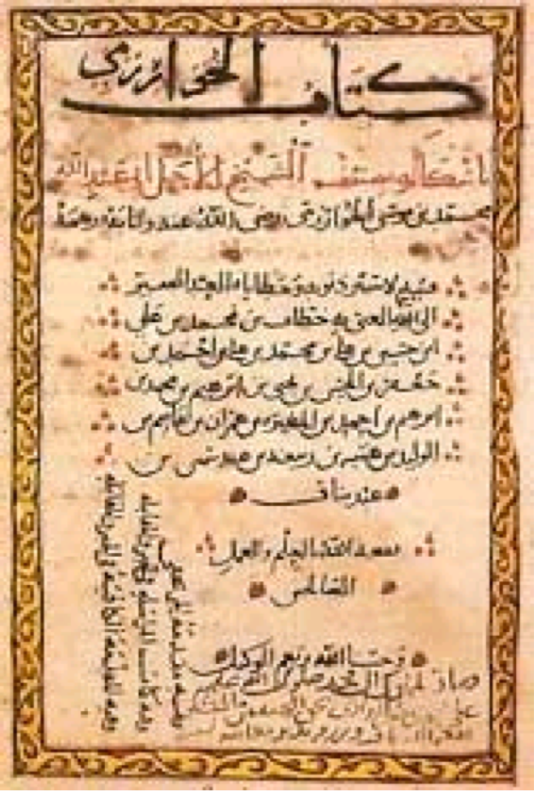
A Page from Al-Khwarizmi’s Book in 820
The Compendious Book on Calculation by Completion and Balancing
Al-Kitāb al-mukhtaṣar fī hīsāb al-ğabr wa’l-muqābala
(Arabic)

Slide 7
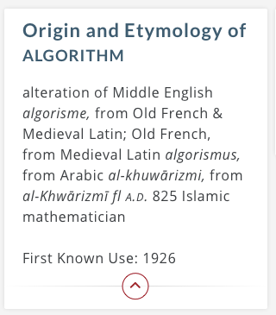

Slide 8
That was a five-minute piece of a theme.

Slide 9
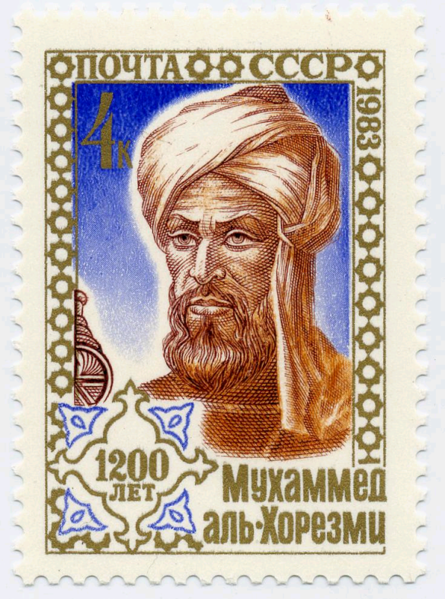
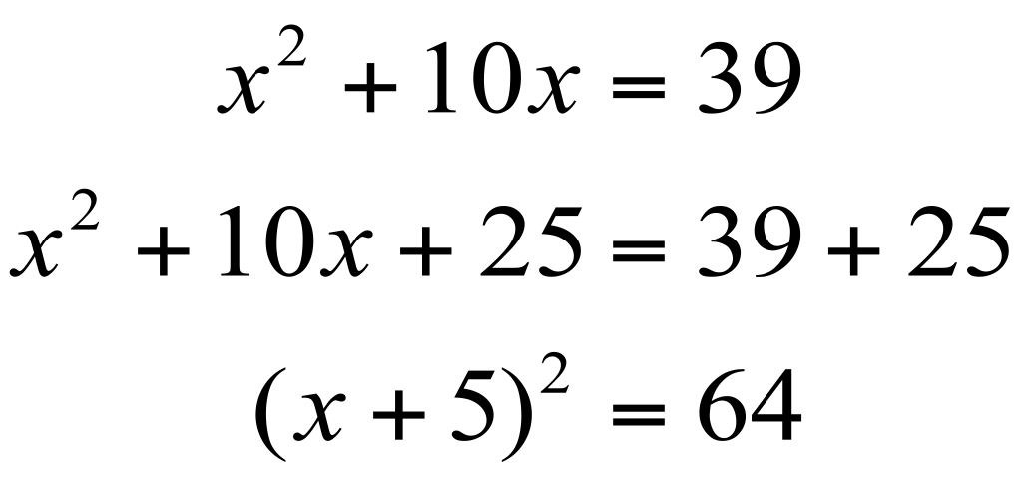
Completing the Square
What is the square which combined with ten of its roots will give a sum total of 39?
Solve
The manner of solving this type of equation is to take one-half of the roots just mentioned. Now the roots in the problem before us are 10. Therefore take 5, which multiplied by itself gives 25, an amount which you add to 39 giving 64. Having taken then the square root of this which is 8, subtract from it half the roots, 5 leaving 3. The number 3 therefore represents one root of this square

Slide 10
The First Day of Class

Slide 11
Number Sequences
and
Inductive Reasoning
Sequence of Odd Numbers
1, 3, 5, 7, . . .
Sequence of Squares
1, 4, 9, 16, . . .
Notes:
Beginning of each term
Inductive Reasoning
Goal: Share with them the thing I like in, and around, mathematics.
And What brought me to mathematics in the first place.
If they start looking for patterns early in the term, I can fit lots of what we do into the context of patterns.

Slide 12
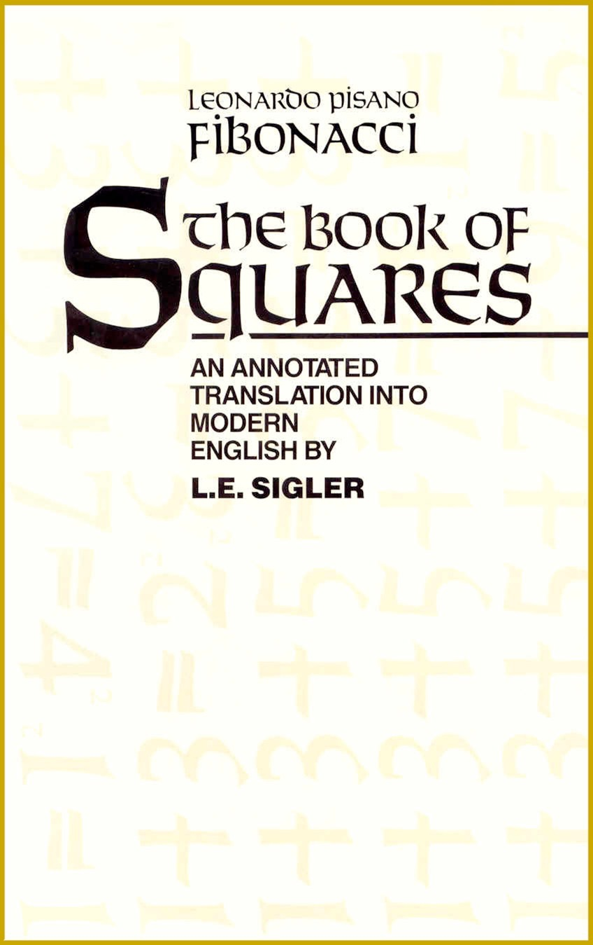
Odds: 1, 3, 5, 7, . . .
Squares: 1, 4, 9, 16, . . .
1 = 1 = 1²
1 + 3 = 4 = 2²
1 + 3 + 5 = 9 = 3²
1 + 3 + 5 + 7 = 16 = 4²
1 + 3 + 5 + 7 + 9 = 25 = 5²
Notes:
On of the things that brought me to mathematics in the first place.
Shouldn’t all our students see this relationship, from basic math through calculus?
I test everything in Elementary Algebra. If it works there, it will work anywhere.

Slide 13
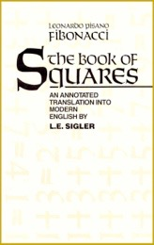
Building Squares from Odd Numbers
Introduction I thought about the origin of all square numbers and discovered that they arise out of the increasing sequence of odd numbers; for the unity is a square and from it is made the first square, namely 1; to this unity is added 3, making the second square, namely 4, with root 2; if to the sum is added the third odd number, namely 5, the third square is created, namely 9, with root 3; and thus sums of consecutive odd numbers and a sequence of squares always arise together in order.

Slide 14
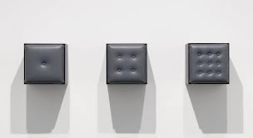
Tony Tasset
Button Progression, 1986
This Will Have Been: Art, Love & Politics in the 1980s

Slide 15
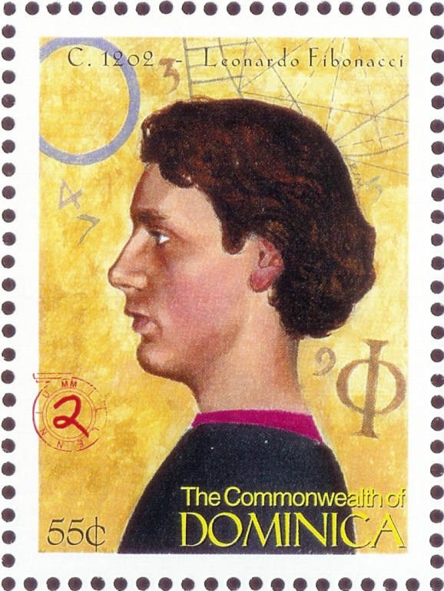
Fibonacci Sequence
1, 1, 2, 3, 5, 8, . . .
Application The number of bees in the family tree of a male honey bee.

Slide 16
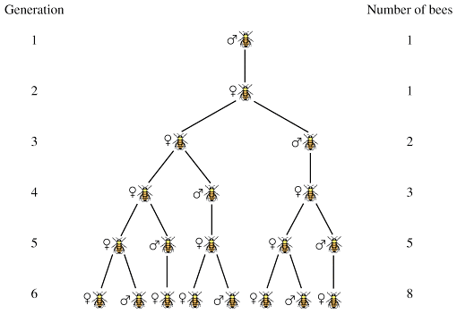
Application: The family tree of a male honey bee.
1
1
2
3
5
8

Slide 17
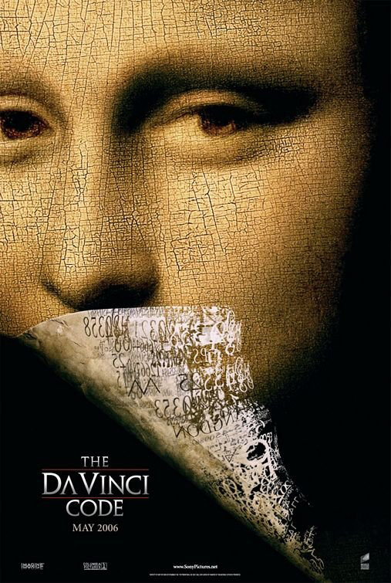
Mathematics Around Us
13-3-2-21-1-1-8-5
O Draconian devil!
Oh, lame saint!

Slide 18
Let’s travel to the birthplace
of Al-Khwarizmi
(I want to show you something interesting.)

Slide 21
What is going on in Baghdad that would inspire someone to write an algebra book?

Slide 22
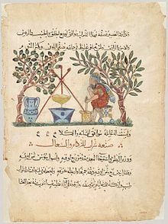
The House of Wisdom (750 CE)
The House of Wisdom was a powerhouse of intellectual exploration and discussion. At one time it held four hundred thousand books. The scholars in the House of Wisdom discovered algebra; were adept at astronomy and navigation; studied the humanities, zoology and geography; as well as medicine, alchemy and chemistry. They translated all the Greek scientific and philosophical texts including those of Aristotle, Pythagoras, Plato, Hippocrates, and Euclid.
13th century Arabic translation of
Materia Medica

Slide 23
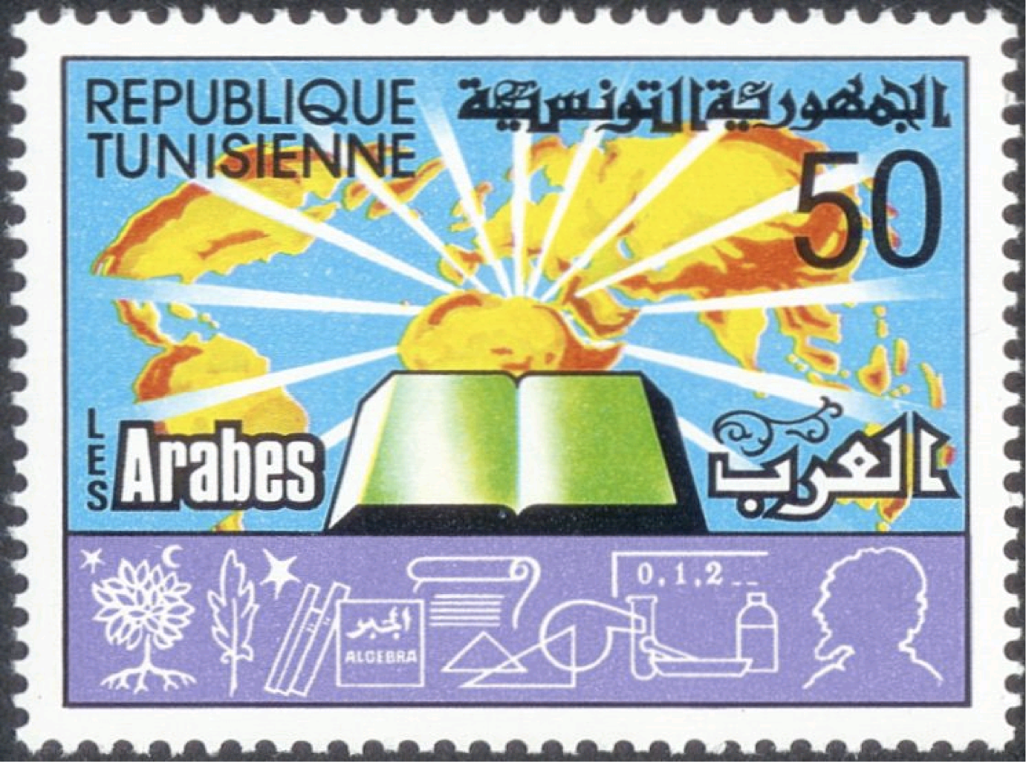
Postage Stamp
Issued by Tunisia in 1979

Slide 25
Modern Jewish Calendar
Between 70 CE and 1178 CE, the observation-based calendar was gradually replaced by a mathematically calculated one as described by the Muslim astronomer al-Khwarizmi (c. 780–850 CE) in 823.
Al-Khwarizmi's study of the Jewish calendar, Risāla fi istikhrāj taʾrīkh al-yahūd "Extraction of the Jewish Era" describes the 19-year intercalation cycle, the rules for determining on what day of the week the first day of the month Tishrī shall fall, the interval between the Jewish era (creation of Adam) and the Seleucid era, and the rules for determining the mean longitude of the sun and the moon using the Jewish calendar.

Slide 26
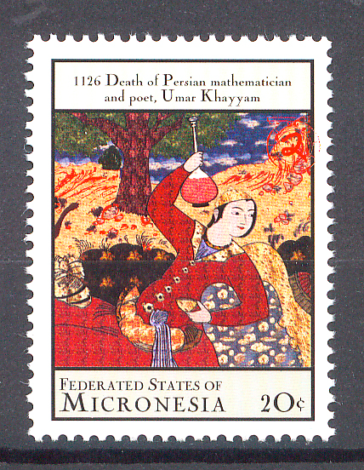
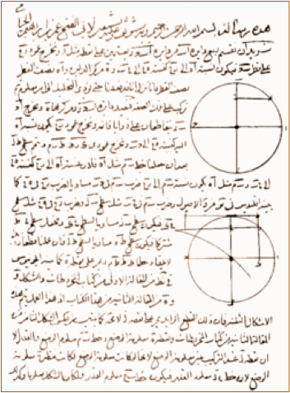
Omar Khayyam
Solving cubic equations by intersecting a circle with a hyperbola.

Slide 28
The Moving Finger writes, and, having writ,
Moves on: nor all thy Piety nor Wit
Shall lure it back to cancel half a Line,
Nor all thy Tears wash out a Word of it.
Omar Khayyam

Slide 29
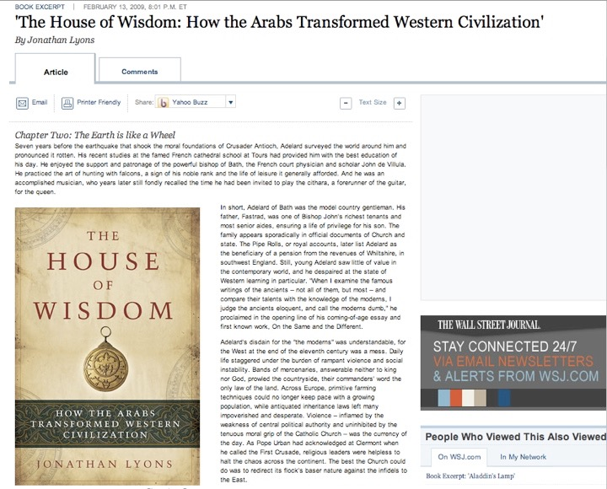

Slide 30
Why establish the House of Wisdom?

Slide 31
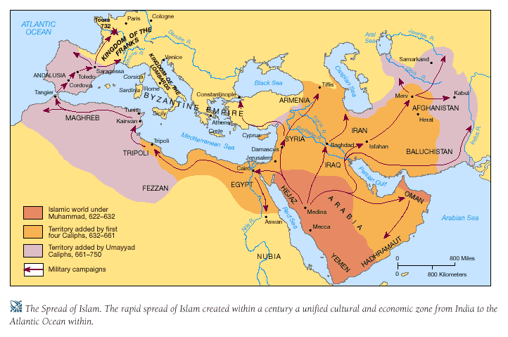
The Muslim Empire
622-750

Slide 32
The ink of the scholar is more holy than the blood of the martyr
The Prophet Muhammad

Slide 33
I’m Catholic

Slide 34
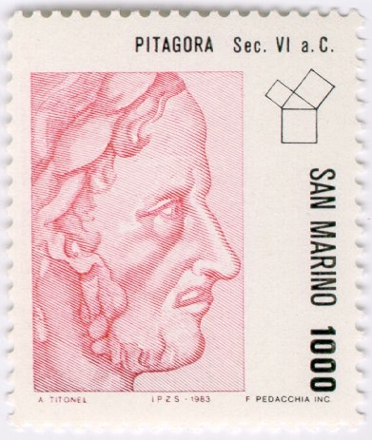
Pythagorean Theorem
In any right triangle, the square of the longest side (the hypotenuse) is equal to the sum of the squares of the other two sides (the legs).
c
b
a

Slide 35
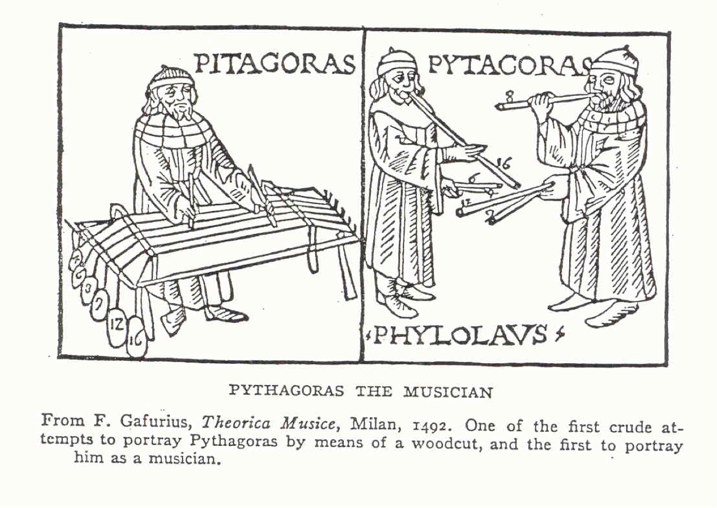
Pythagoras and Music

Slide 36
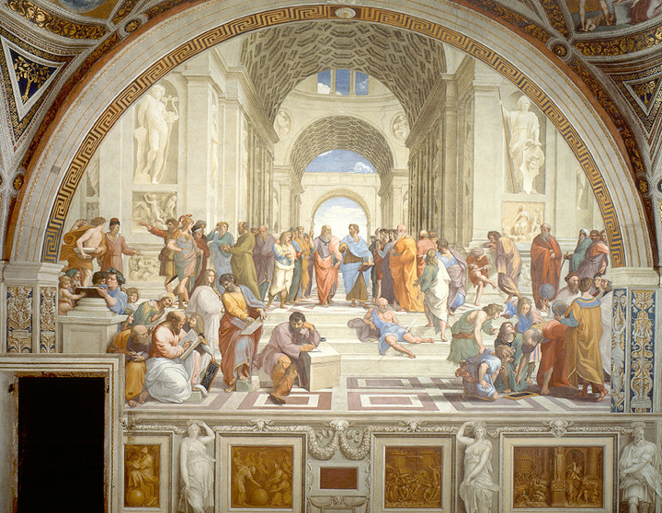

Slide 37
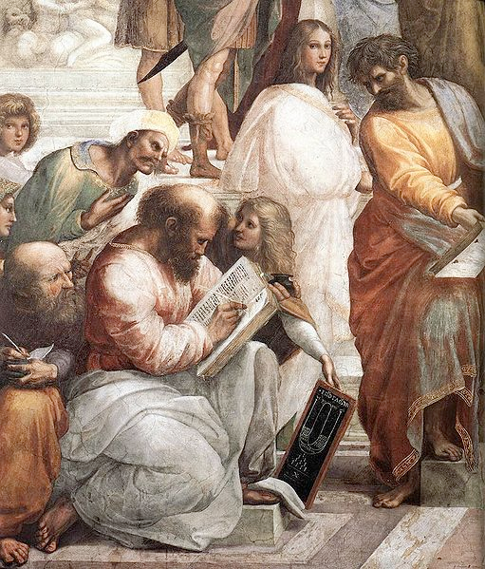

Slide 38
Pythagoras and Shakespeare
Thou almost mak’st me waver in my faith,
To hold opinion with Pythagoras,
That souls of animals infuse themselves
Into the trunks of men.
Merchant of Venice

Slide 39
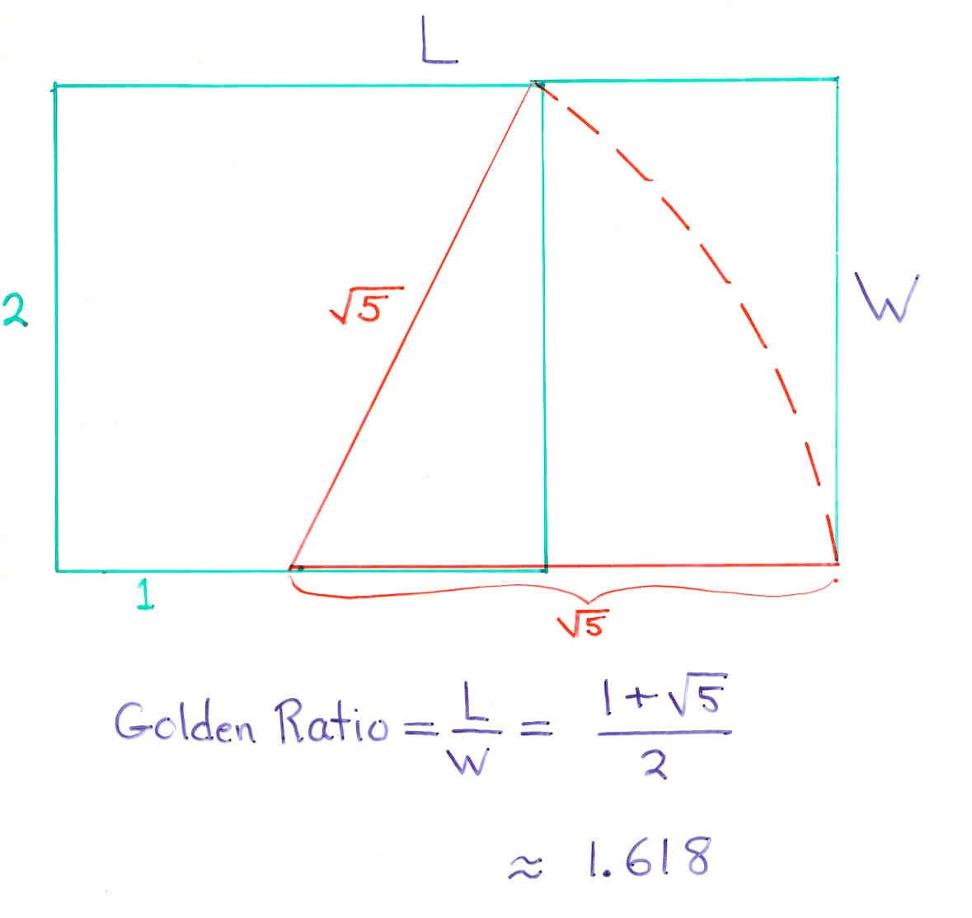
The Golden Rectangle

Slide 40
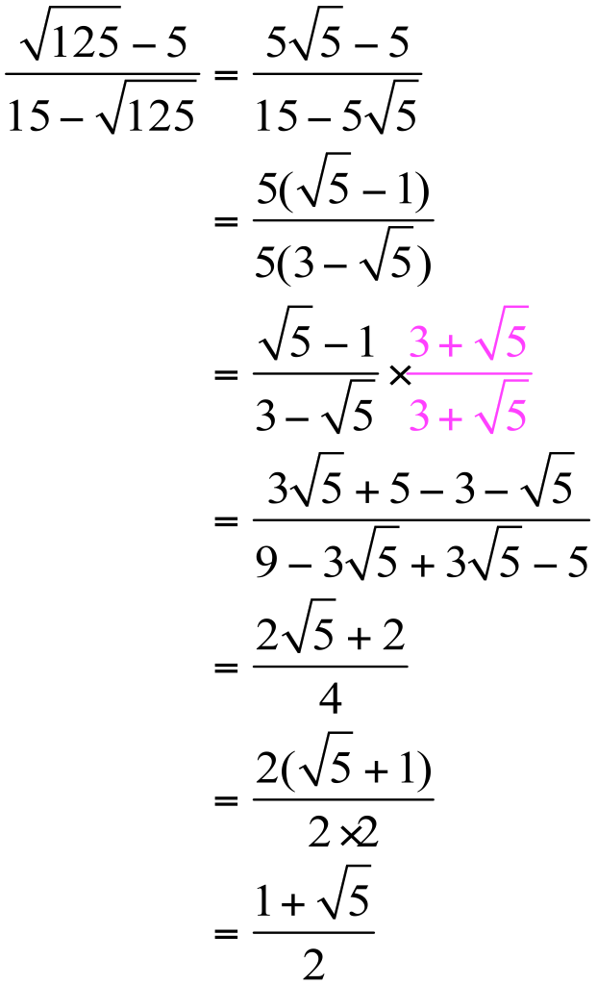
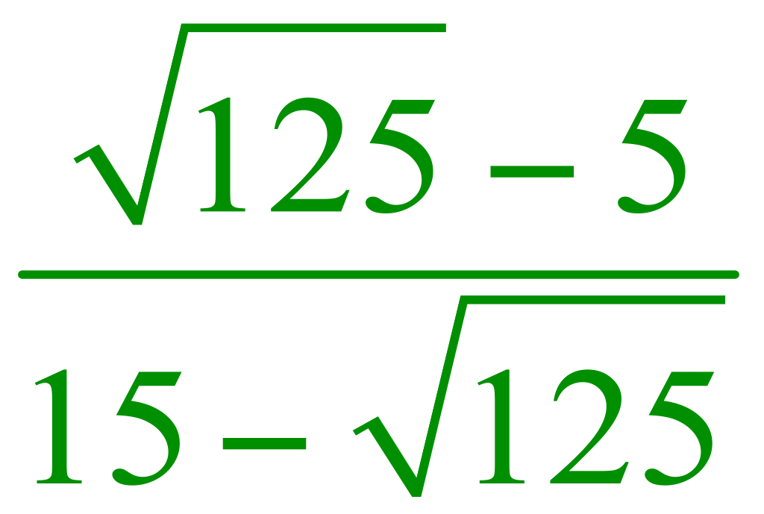
Al-Samawal
Born: about 1130 in Baghdad, Iraq Died:about 1180 in Maragha, Iran
The golden ratio is

Slide 41
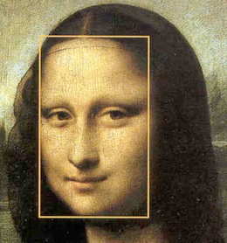

Slide 42
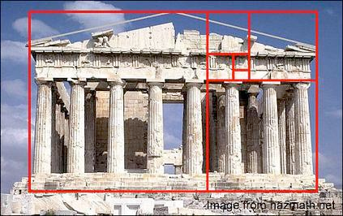

Slide 43
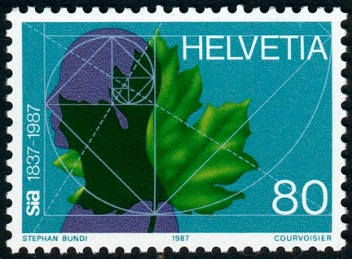

Slide 44
Approaching the Golden Rectangle with the Fibonacci Sequence
2
3
1
1

Slide 45
2
3
1
1

Slide 46
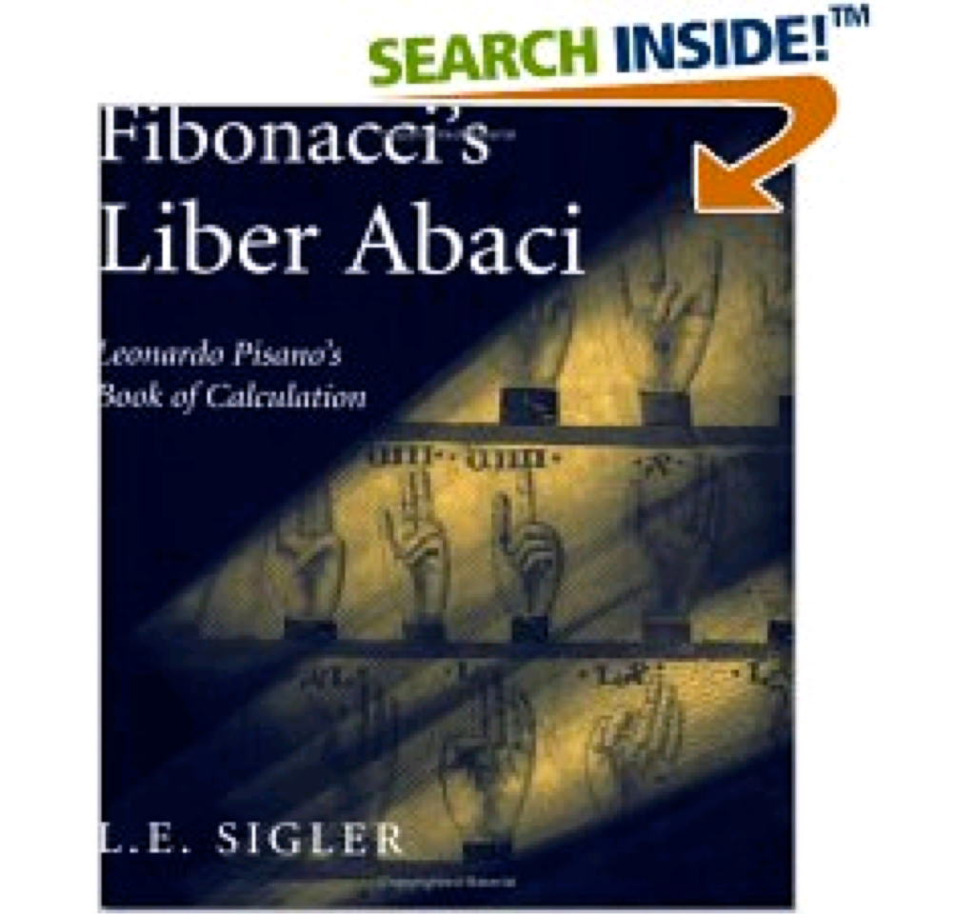
Amazon.com
First published
in 1202
This translation:
2003
MAA Online, March 2003:
“The Liber abaci of Leonardo Pisano (today commonly called Fibonacci) is one of the fundamental works of European mathematics. No other book did more to establish the basic framework of arithmetic and algebra as they developed in the Western world.”

Slide 49
School of Translation
Ken Follett, The Pillars of the Earth, Page 688: Jack was living with a small group of English clerics in Toledo. They were part of an international community of scholars that included Jews, Mulsims and Arab Christians. The Englishmen were occupied translating works of mathematics from Arabic into Latin, so they could be read by Christians. There was an atmosphere of feverish excitement among them as they discovered and explored the treasure-house of Arab learning, and they had casually welcomed Jack as a student: they admitted into their circle anyone who understood what they were doing and shared their enthusiasm for it.
What were they like?

Slide 50
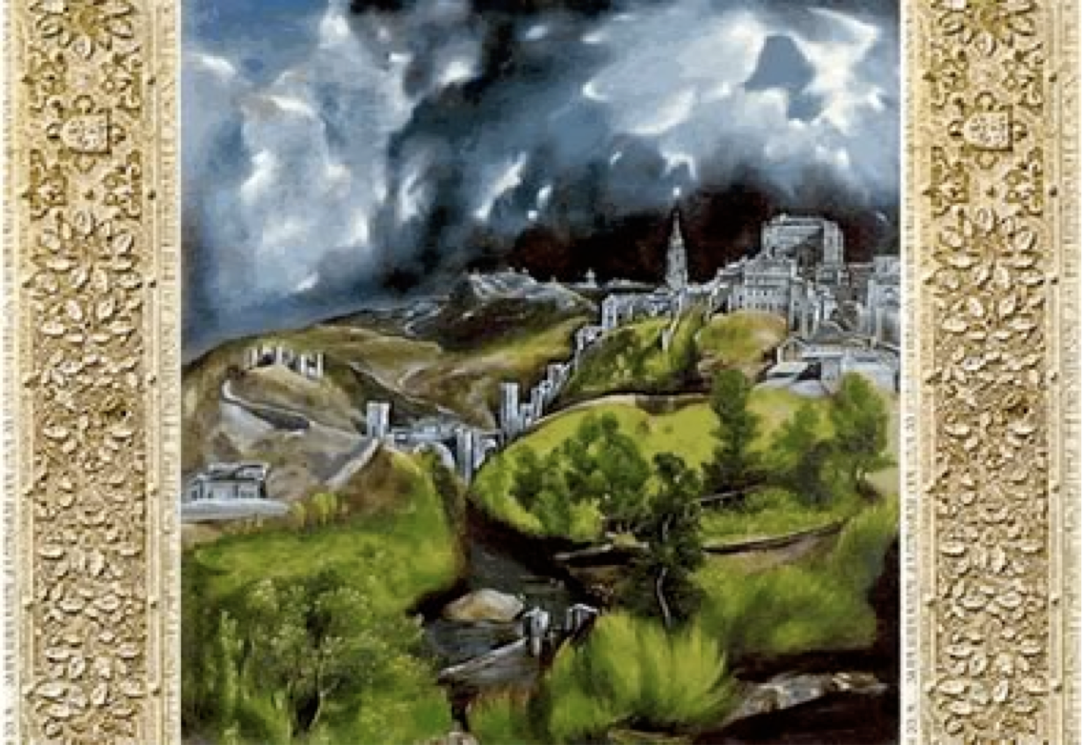
Toledo, Spain
School of Translation, 1150
Keith Devlin:
Latin was the language of the European scholars, and thus the target language for the translations. Since few European scholars knew Arabic, however, the translation was often done in two stages, with a Jewish scholar living in Spain translating from the Arabic to some common language and the visiting scholar then translating from that language into Latin. In the same way, many ancient Greek texts, from Aristotle to Euclid, were also translated into Latin, whereupon they began to make an impact in the West
View of Toledo by El Greco

Slide 51
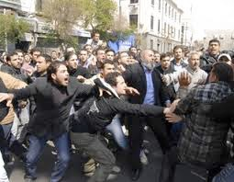
The Small Picture, that we get from the media, takes place over a short period of time. It polarizes us. It is not a hopeful picture.
The Middle East in the Media
The Big Picture takes place over a longer period of time. It is not polarizing. In fact, the more we study history, the more we find ourselves identifying with people from the past.
View of Toledo by El Greco

Slide 52
Elementary Algebra Themes
Method I reserve five minutes of each class session to bring in the things that you think are interesting in, and around, mathematics.
Target Audiences
All Students
Student like me in the 60s
Muslim Student

Slide 53
The End

Slide 54
Speaking to Students

Slide 55
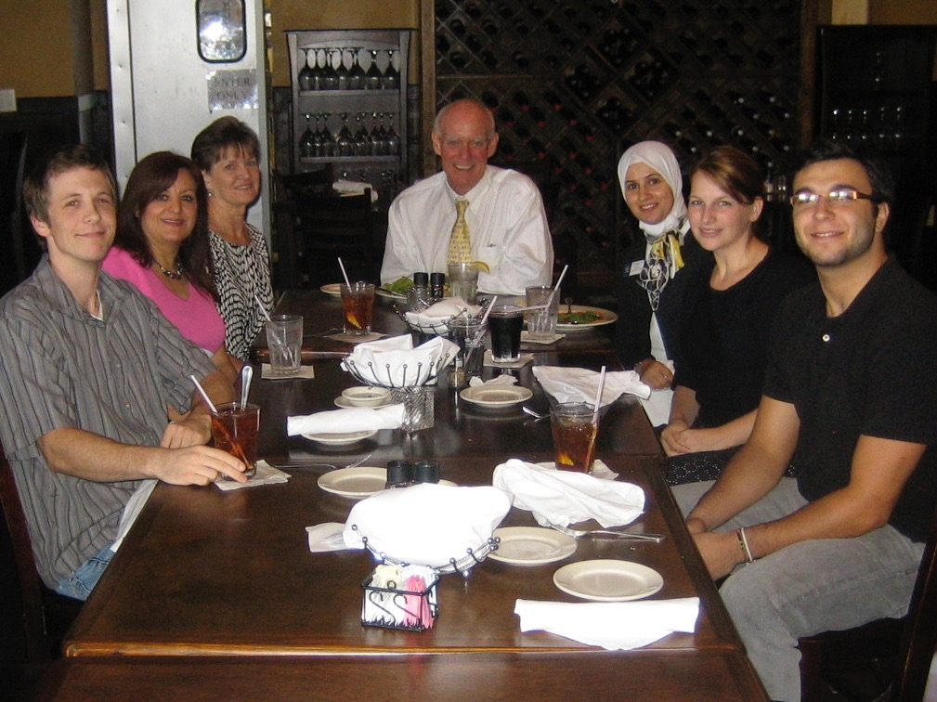

Slide 56
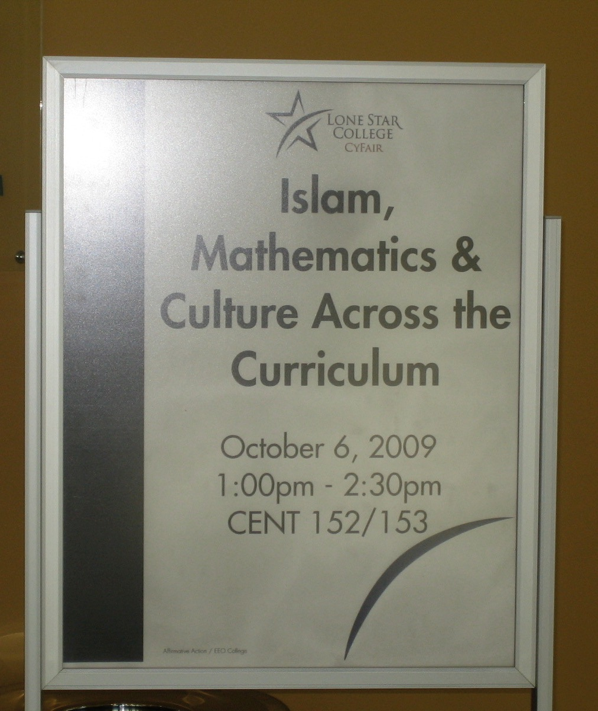

Slide 57
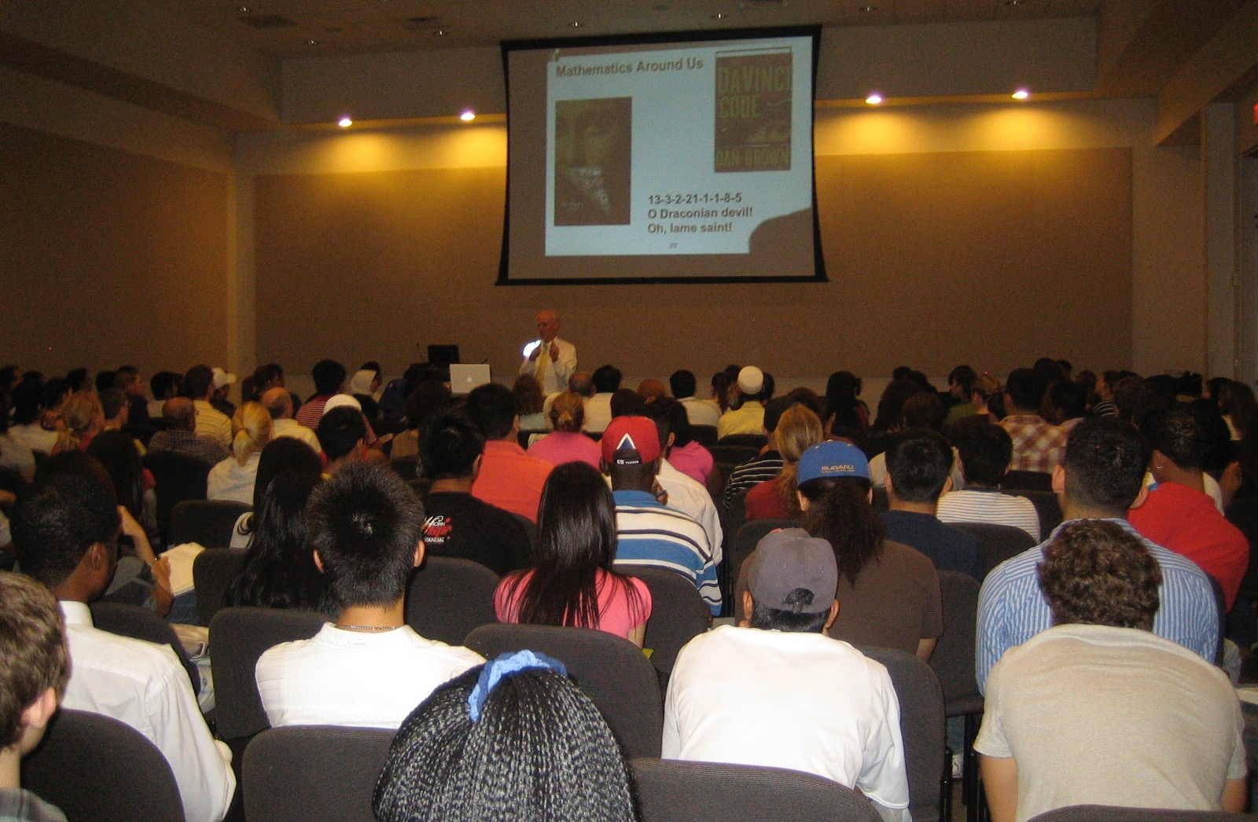

Slide 58
